Slide 1

Employer Engagement:
What do we know?
Professor Jo Ingold FIEP
ERSA Employer Engagement Forum
21 January 2026
Notes:
I acknowledge and pay respect to the ancestors and descendants of the Lands upon which we meet. I am mindful that within and without the buildings, the Land always was and always will be Aboriginal Land.
Yugambeh/Kombumerri peoples.
I’ve been researching employer engagement for 13 years and today I’m going to provide a quick Top Ten sprint about what I’ve learned

Slide 2
Quick note on the evidence base
Survey of 650 businesses (Leeds & NY Chamber)
40 interviews with Work Programme providers
Survey of 305 businesses (in conjunction with Prime provider)
Survey of 1,500 businesses in UK and Denmark
101 interviews with businesses & providers in UK & Denmark
30 interviews with businesses in Australia
120 interviews with businesses, policymakers, employment& training providers in UK, Australia and US
Masterclasses with 50+ businesses & employment service providers in Australia
Other ad hoc studies and research consultancy

Slide 3

What is employer engagement?
Notes:
There are lots of typologies around - propensity to engage, reasons for engagement, extent of engagement
Intention vs actual (Martin and Swank UK and Denmark)
It is not sending an employer 100 resumes (spray and pray)
From my early research in the UK I developed the idea of Two faces of employer engagement
1. Provider practitioner attempts to build and maintain relationships with employers
2. employer engagement beyond vague participation in a program, including hiring and retaining and use of HR services provided by provider practitioners
Now the Top Ten Messages about Employer Engagement

Slide 4
1. You have more than one customer
Government
Employers
Candidates
Notes:
There is a small but growing evidence base about the demand-side
It tends to be absent (or secondary) to policymaking and scholarship regarding ALMPs
I’m presenting key dimensions of the evidence base from interviews with employers (hiring managers) and providers in the UK, Denmark and Australia
I also like to talk about two sides of the same coin

Slide 5

2. You need to know your customers
Notes:
Employers don’t always know what they want or need
Sometimes practitioners are uncomfortable about the idea of selling their clients but employer engagement is at root a sales activity. But done well it is far more than this

Slide 6

3. Employers don’t know about you
Notes:
Again, sales
Employers may or may not have any understanding about hidden talent or your services
They don’t know that you or your clients are gold or that your services might be gold
Employer engagement is about your candidates and service quality that you provide

Slide 7

4.Employers may be skeptical
Notes:
They may have been burned before

Slide 8

5. Employer engagement is about relationships
Notes:
IPS three cups of tea
Understanding the business you approach, their workforce needs. Often this involves listening to the employers and sometimes challenging their labour market assumptions and their HR policies and practices
You should be labour market experts

Slide 9

6. Employer engagement is about reciprocity and trust
Notes:
Employer engagement is not an economic exchange
It’s a social exchange within an economic context
Reciprocity means one party initiatives an action and the other responds – hopefully positively

Slide 10

7. Employer engagement requires specific skills
Notes:
Resilience, persistence
Listening
IPS – there is crossover in the skills that are important for clients
But every organization should have a specific employer engagement team with individuals that manage relationships – single point of contact

Slide 11

8. Don’t forget your internal relationships
Notes:
Don’t forget to not only focus on external relationships with employers and other providers and partners but also on your internal relationships i.e. job consultants/mentors who have daily contact with candidates

Slide 12

9. Always under-promise and over-deliver
Notes:
Ive heard so often from employers ‘I was promised this, 50 people, but they didn’t materialize’ or ‘I received 100 resumes and it created more work for me’
‘I spend ages talking with the provider-practitioner but they didn’t listen’
‘wasted my time’
Always provider a gold standard service
Employer engagement is about your candidates and service quality that you provide

Slide 13

10. Co-opetition
Notes:
In the UK the ReAct partnership has for the past few years led to collaboration amongst providers for the benefit of employers – so employers receive a variety of candidates but the competition is hidden from them
Hide the wiring as I call it
The department in the UK also incentivizes collaboration

Slide 14

Resources
Activating Employers - https://activatingemployers.org
Australian Research Council Linkage on Job Quality and Employment services - https://www.goodworkresearchgroup.com

Slide 15
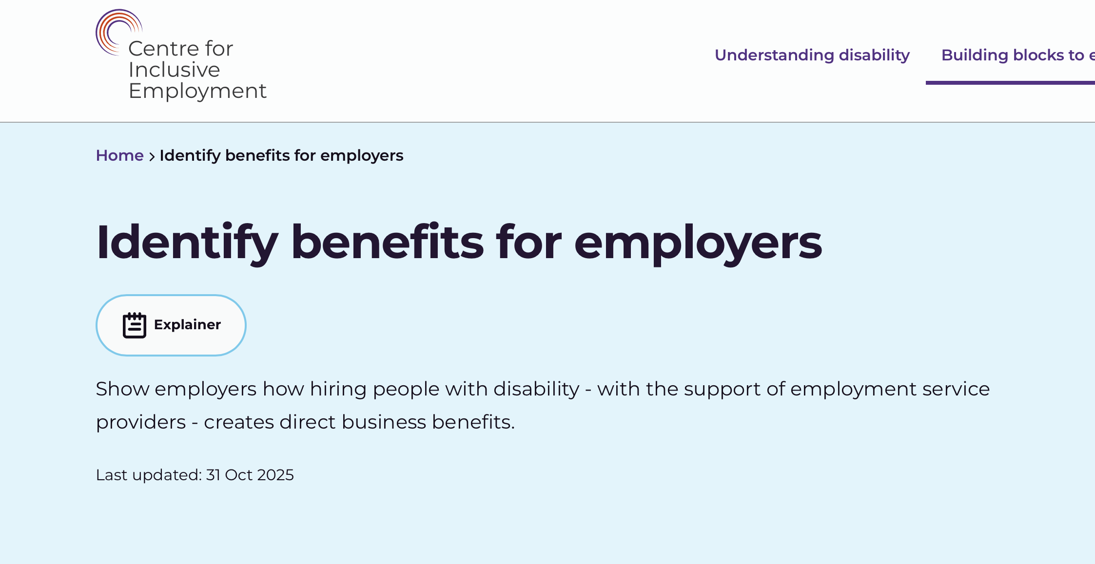
Rapid Review of Employer Engagement
Centre for Inclusive Employment:
https://www.centreforinclusiveemployment.au

Slide 16
Aims of the Review
What are the effective employer engagement practices that lead to increased employment and retention especially for disabled people in the mainstream labour market?
2. What are the: (i) activities undertaken? (ii) the intensity of those activities?
3. What are the differences, if any, in employer engagement practice for specific cohorts of jobseekers with disability?

Slide 17
Resources we’d like to review include:
toolkits
frameworks
models
evaluations
policy papers
case studies
other practical resources
practice-based academic evidence

Slide 18
Please join the slido!

Slide 19
Is there anything else you’d like to add?

Slide 20

Thank you
Please send resources to Dr Qian Yi Lee Qian.Yi.Lee@acu.edu.au or feel free to contact: jo.ingold@acu.edu.au
https://www.goodworkresearchgroup.com

